Slide 1
THE 1930S
Crash, Depression and The New Deal

Slide 2
Warning Signs and Causes
Prosperity of 1920s – US stocks top out and unemployment way down
Welfare capitalism, certain industries in trouble
Warning signs *** and Causes:
One sided wealthy – very few controlled $ and industry in US
Debt/credit skyrockets
Middle/poor class buy stocks on credit (margin), which leads to ridiculous amount of interest
Farmers go broke – hard decades IN BOTH the 1920s & 1930s
Factories overproduce – not enough buyers
Rural Banks close due to no money supply
Bull Market – has to pop eventually

Slide 3
Crash Events
Oct 24, 1929 – Black Thursday – stock values begin to fall, b/c investors begin to sell stock
Oct 29, 1929 – Black Tuesday – millions of shares sold to avoid further losses – the Great Crash!
Government protections are virtually non-existent – laissez faire
Stock Market Crash – CATALYST of the Great Depression, 1929-1945

Slide 5
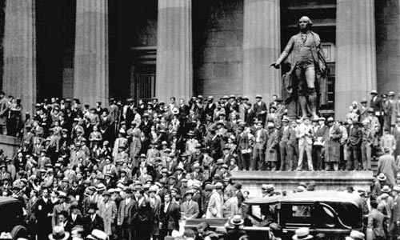

Slide 6
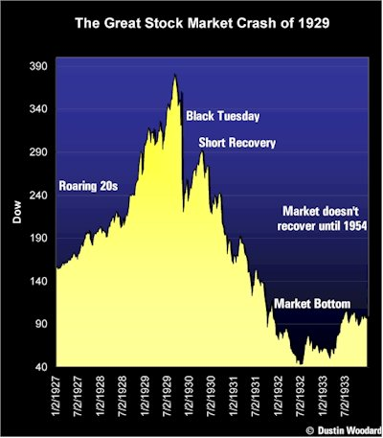

Slide 7
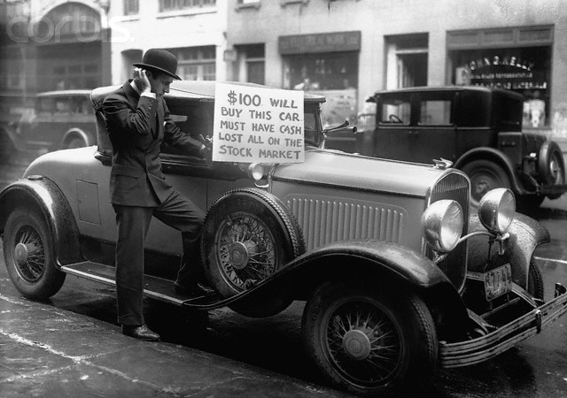

Slide 8
Effects of Crash
Factories close – no unemployment service
Part time work only if out of work
25% UNEMPLOYMENT
Federal Reserve lower loan rates – only hurts more
Small businesses close
Farming prices drop 60%!
Consumer spending non-existent
Banks shut down – call in loans, people withdraw $ from banks in fear, mattresses, banks go under
** Banks Had invested deposits in stock markets
Bank Closing = NO MONEY FOR YOU
Global trading – most other industrial nations start Depression
Health, well-being, crime, morale, divorce rates, birth rate
ALL ASPECTS OF LIFE ARE EFFECTED

Slide 9
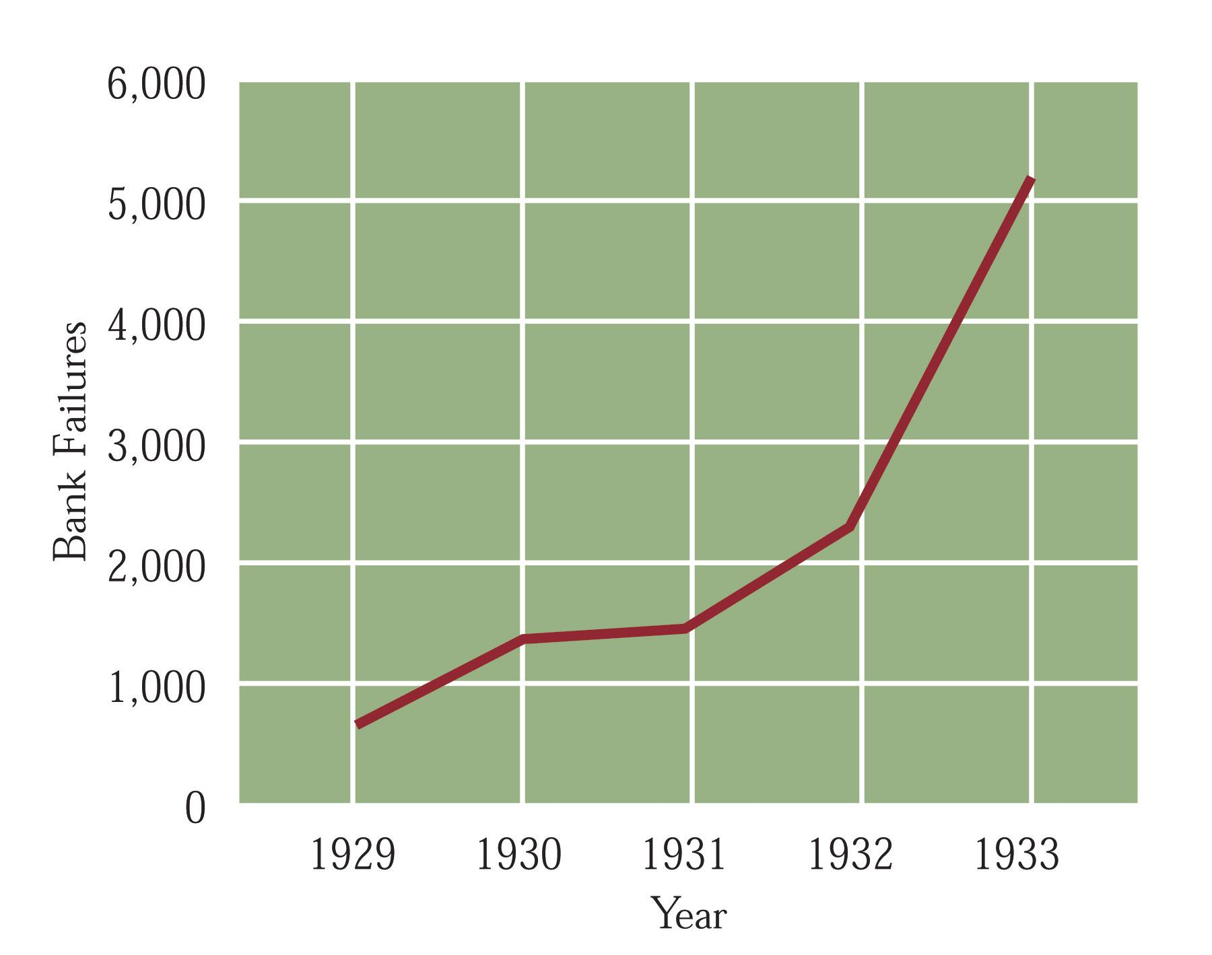

Slide 10
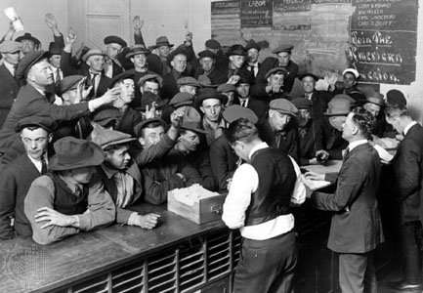
Mad Dash to the Banks

Slide 11
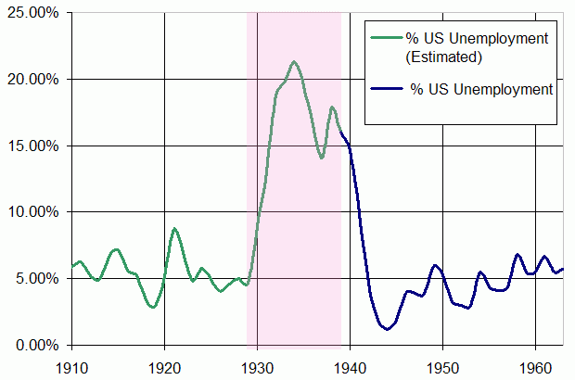

Slide 13
Republican Presidents of 1920s:
Harding: Wanted NORMAL LIFE after War/laissez faire
Coolidge: Laissez faire of business and stocks
Hoover: Minimal regulation and no real help to needy and jobless during Depression years
People will want dramatic change VERY SOON!

Slide 14
Government Response 1929-1932
Hoover says “Depression is Global, not Domestic” Said:
States and local gov’t should be in charge of relief
Public Works projects, funded by banks (that are not out of business)
Raise tariffs (Promote American made) – Hawley Smoot tariff
Lower mortgage rates (Home Owners Loan Corp)
Reconstruction Finance Corps – send money to banks in danger of failing, but not enough, and not quick enough
Bonus Army fiasco – send army to break up demonstration of WWI vets who want pensions early
“pull yourself up by your boot straps” – not the gov’ts job to ‘cure’ poverty, homelessness and joblessness

Slide 15
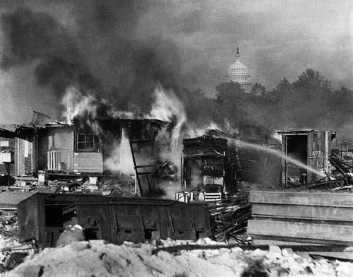

Slide 16
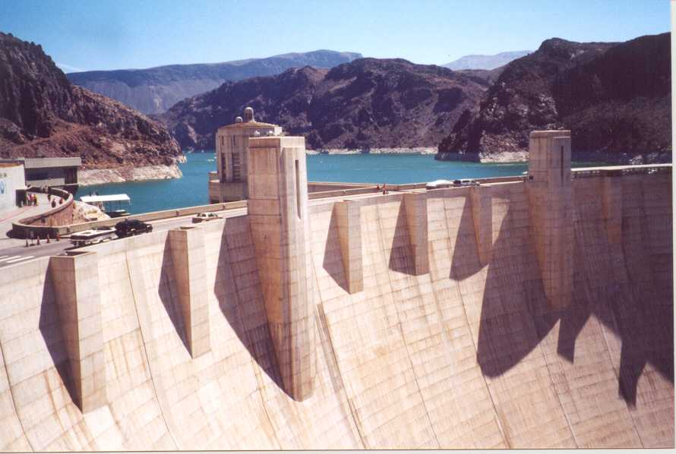

Slide 17
Society Changes
Dust Bowl, migration to CA – “Oakies”
Lack of crop rotation PLUS drought = disaster
In retaliation of government, farmers destroy crops food supply shortage
Crime – Bonnie and Clyde – heroes
Theft, boot legging
People ride trains illegally – “Rail boys”
Families
Divorce drops
Drop out rate of school up
Crime and suicide both up
Races
Blacks fired to give jobs to whites, both in North and South

Slide 18
Hoovervilles – homeless shanty towns

Slide 19
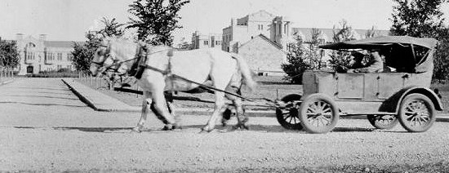
Hoover wagons

Slide 20
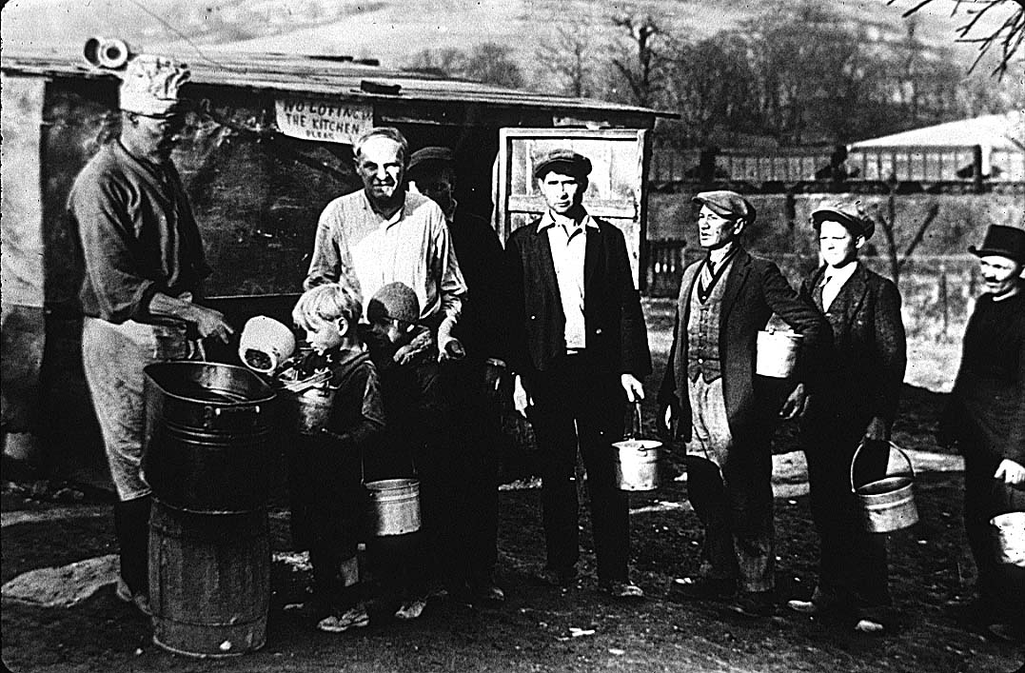

Slide 21
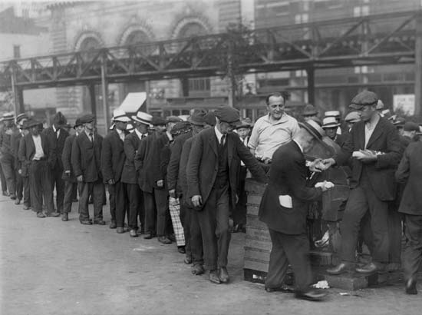

Slide 22
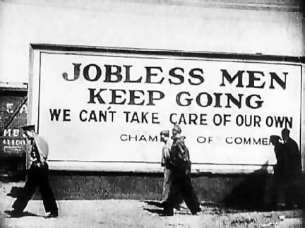

Slide 25
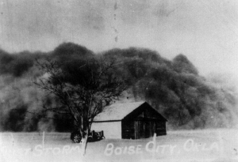
Dust Storm in Oklahoma

Slide 27
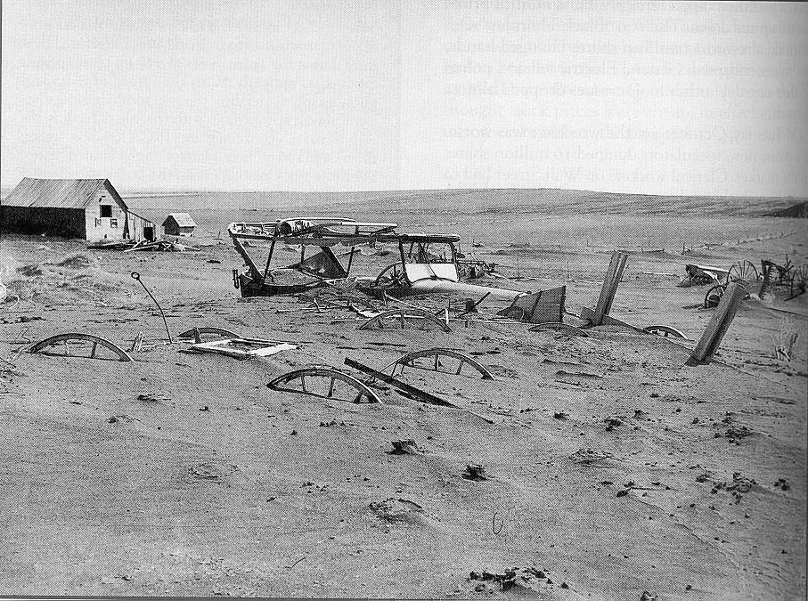

Slide 28
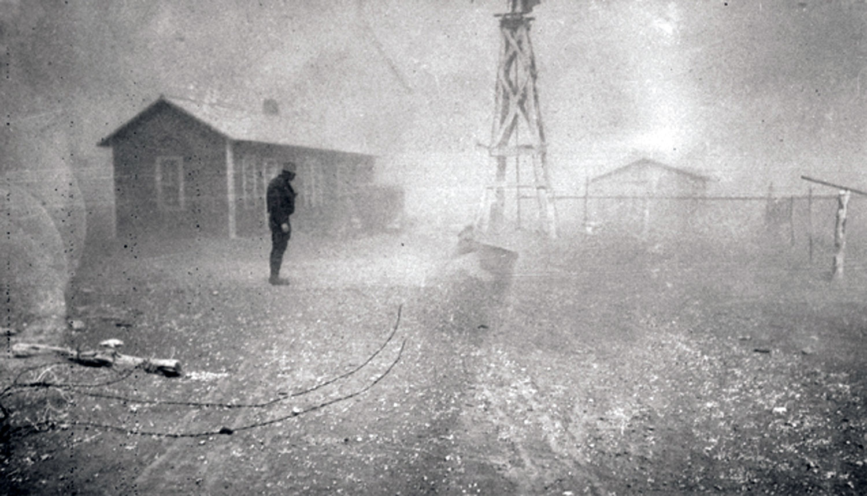

Slide 29
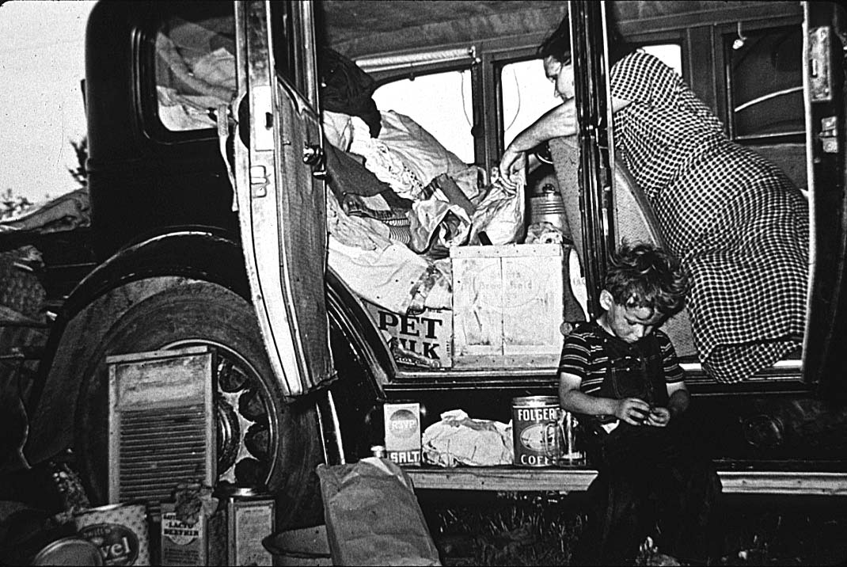

Slide 30
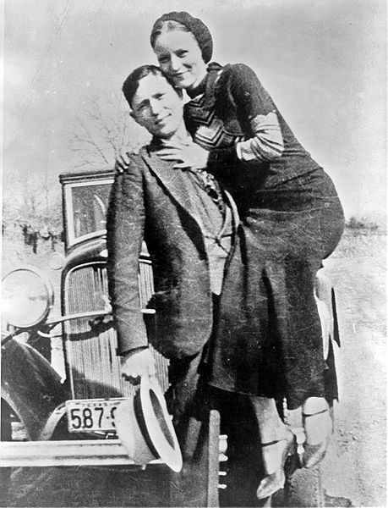

Slide 31
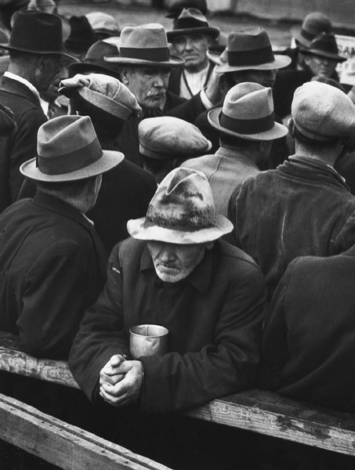

Slide 32
Ch 18: Franklin Delano Roosevelt – Election of 1932
FDR – seen as ‘ordinary guy’ and optimistic
Wins in landslide – “we have nothing to fear but fear itself”
Also – wants to help people economically --- sees as gov’t responsibility in times of crisis
New Deal and fireside chats → would he have been elected if there was a TV in every home?
Keynes economics – gov’t spending = recovery
“New Nationalism” – gov’t works with business to get out of financial ruin
** Election of 1932 will change the way Americans see the role of government and social welfare programs
New Deal is what FDR promises to promote economy, jobs, and end homelessness – RELIEF, RECOVERY, REFORM
Eleanor is wife – promotes New Deal – takes on new role as First Lady
Will be known to fight for children, poor, African Americans, women

Slide 33
Eleanor – A New Kind of Frist Lady First To Make Speeches WITHOUT Her Husband
“A woman is like a tea bag… you never know how strong she is until you dunk her in hot water.”
“If a friend fools you once, shame on them. If they fool you twice, shame on you.”

Slide 34
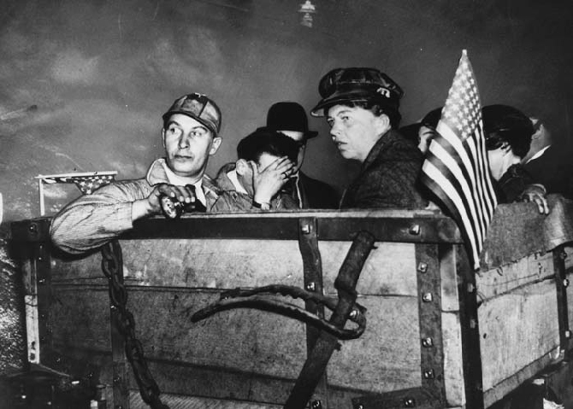

Slide 35
Covering up the Polio

Slide 36
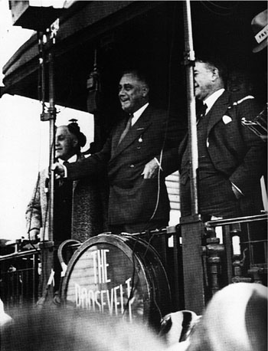
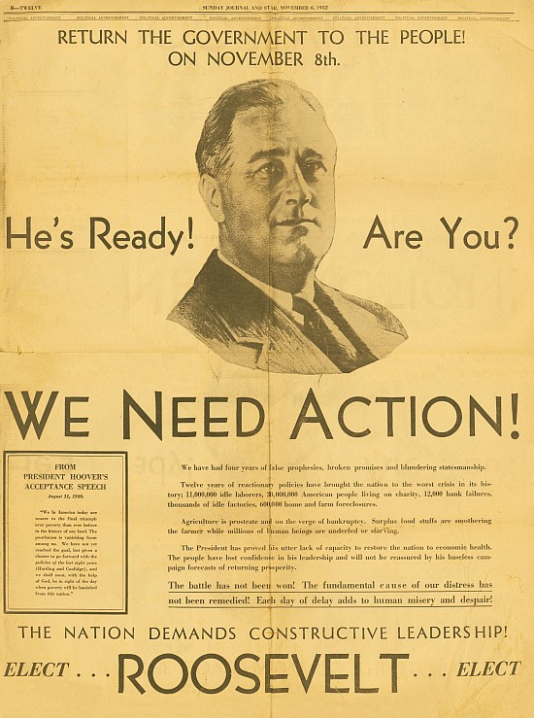

Slide 37
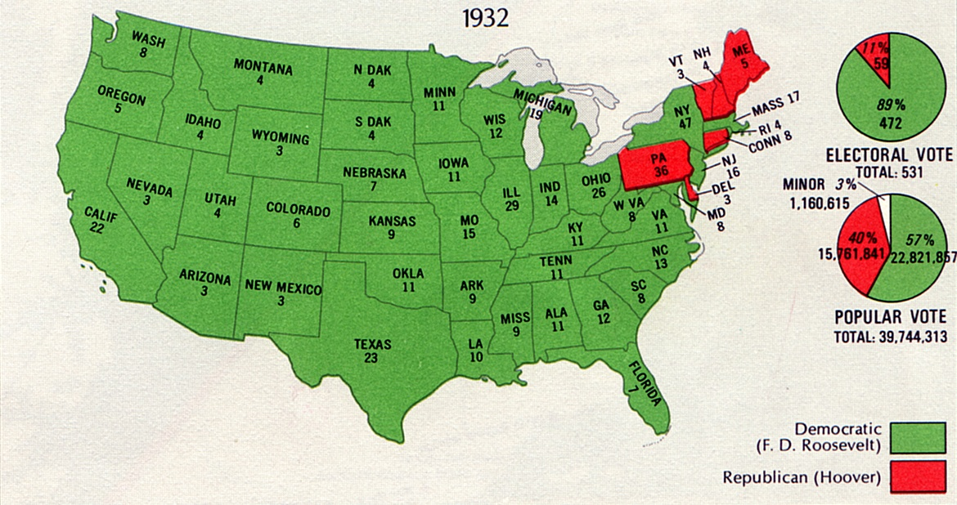

Slide 38
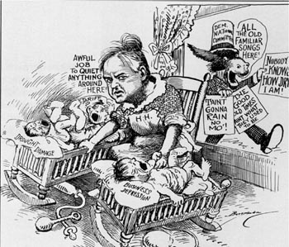

Slide 39
New Deal- Government steps in to help people! RELIEF, RECOVERY, REFORM
First One Hundred Days of presidency
1. Emergency Banking Act
Banks closed, and inspected by gov’t – bank holidays to keep from further withdrawals
Result: people confidant again to store money in banks, banks can make interest and make loans
Glass Steagall Act – FDIC/ no speculation on stock market from banks
2. Federal Emergency Relief Administration
Public Works Administration- construction work
Civil Works Administration (CWA) – 4 mil jobs created improving roads, parks, etc.
Civilian Conservation Corps (CCC) – men restore national parks, beaches, forests, etc.- FDR’s favorite and most celebrated

Slide 40
RELIEF, RECOVERY, REFORM…Continued
3. National Industrial Recovery Act(NIRA)
Increases industrial prices - sets up codes of fair competition
Sets wages, hours, conditions of workers – Fair Labor Standards Act
4. Securities and Exchange Commission (SEC)
Regulates trade and stock
5. Tennessee Valley Authority (TVA)
Provide cheap electric and hydro electric to Appalachian region – in exchange of coal
6. AAA – Agricultural, raise farm prices/ paid farmers NOT to grow crops, or kill livestock

Slide 41
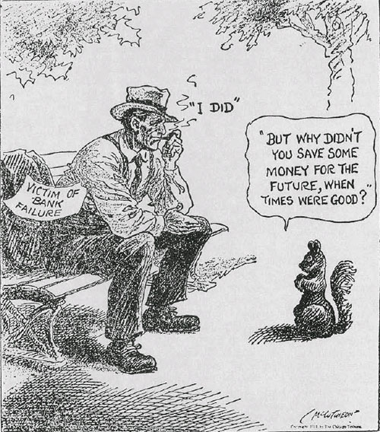
First on FDR’s List…

Slide 42
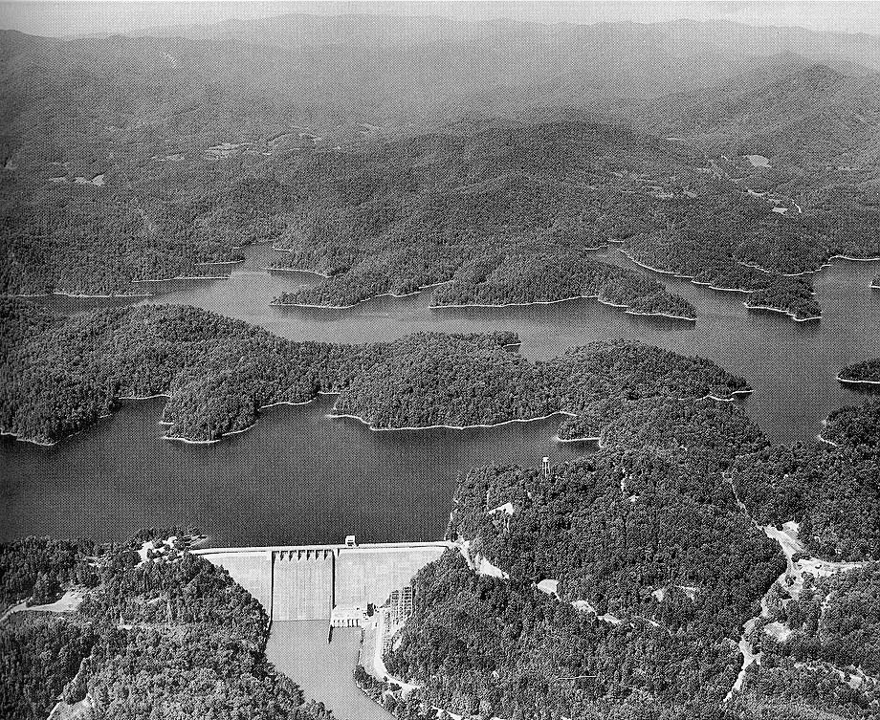

Slide 43
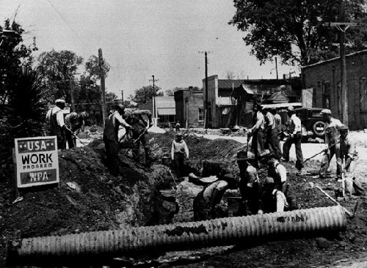

Slide 44
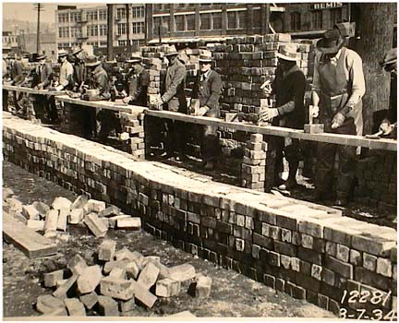

Slide 45
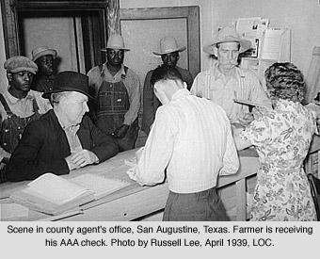

Slide 46
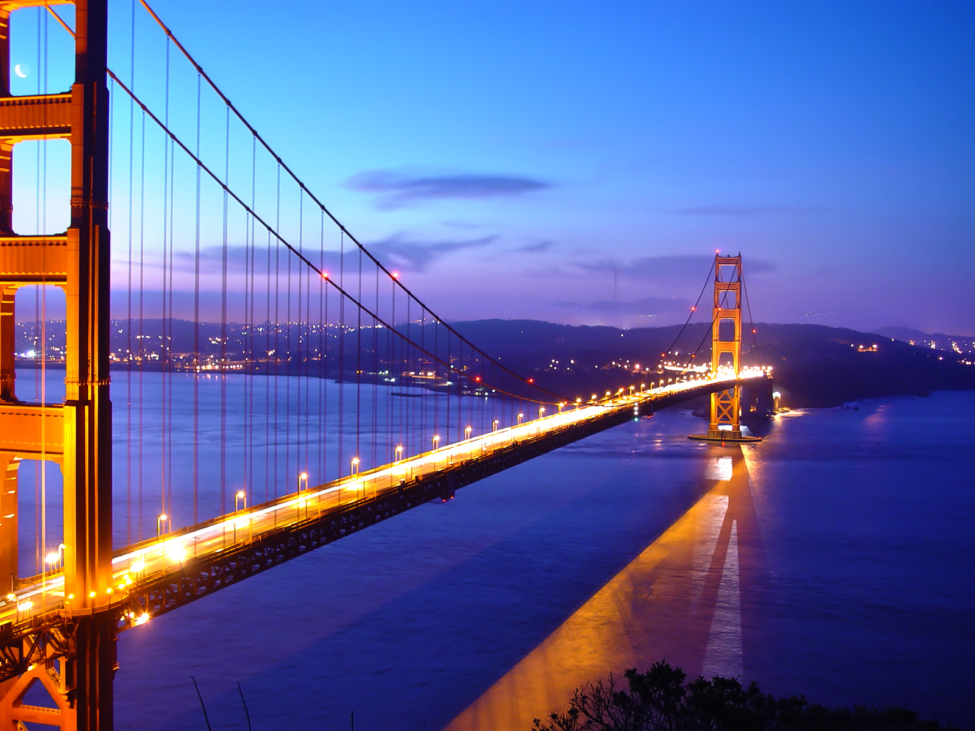

Slide 47
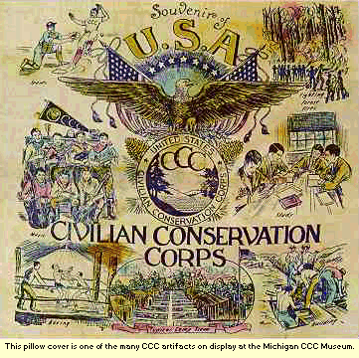
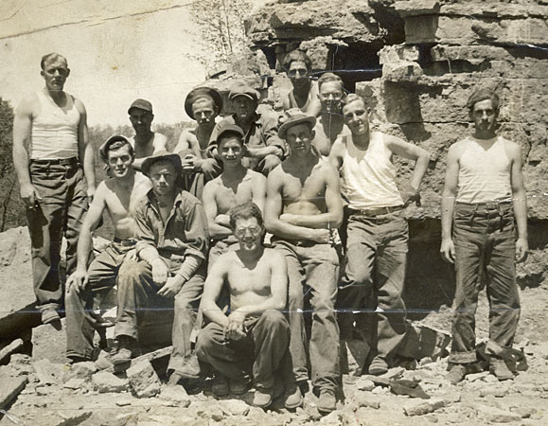
CCC

Slide 48
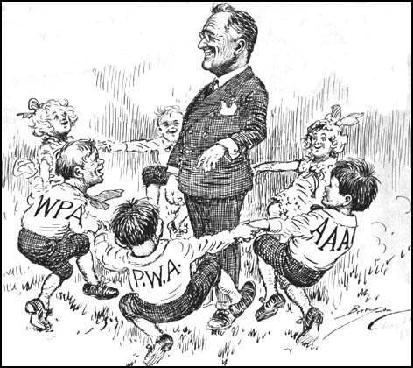

Slide 49
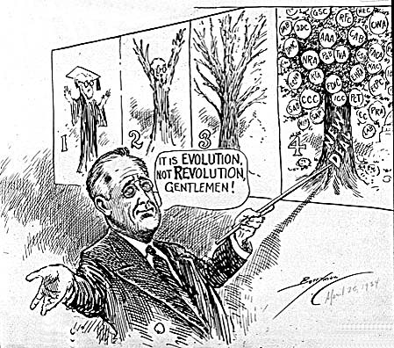

Slide 50
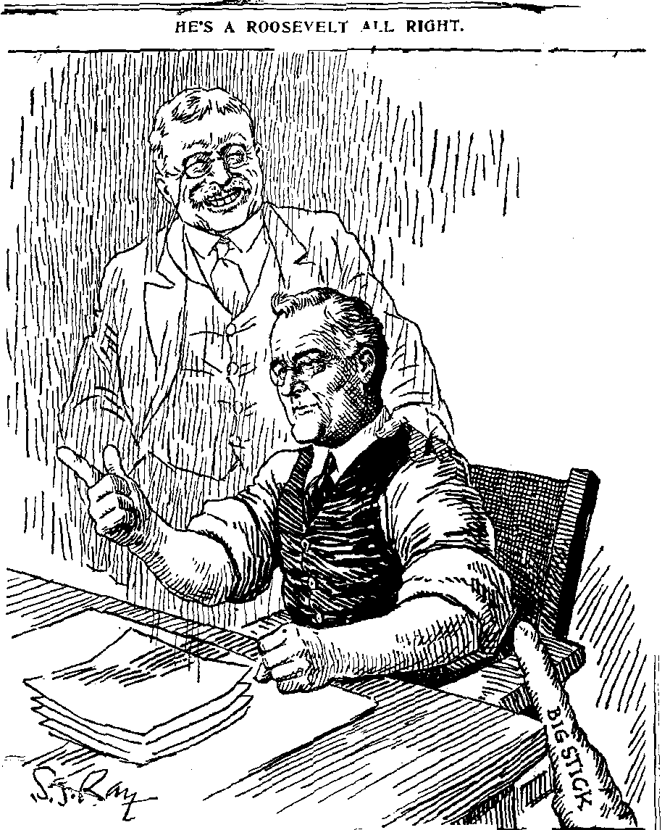

Slide 51
FDR Criticized
** some see these agencies as unconstitutional
Deficit Spending and Keynesian- even when the gov’t doesn’t have the money to spend, they must in order to stimulate the economy
“Black Cabinet” – Eleanor and FDR promote more African Americans than any other president up to date
Court Packing! – separation of powers violated???
In response to NRA and AAA deemed uncon.
Eventually, FDR appointed 9 justices
American Liberty League – formed to oppose New Deal

Slide 52
Second 100 Days/2nd New Deal
1934, 1 year later- focused on ‘average’ American and welfare state
1. Works Progress Administration – increased projects/jobs
2. Farm Security Administration
3. National Housing Act – low cost housing – government buys faulty mortgage notes
4. Wagner Act passed
Legalizes unions and maintains fair practice
Child labor illegal, and minimum wage set
5. Social Security – gets elderly out of work force
Retirement funds at 65 years
Unemployment insurance
Physically handicapped

Slide 53
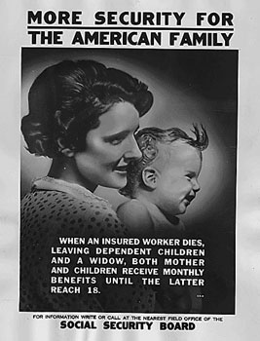

Slide 54
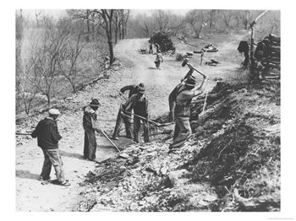
CWA

Slide 55
FDR wins second election, but New Deal sees criticism by rich, Republicans, and big business
New Deal did little for women, blacks, minorities
FDR afraid of alienating Democrat voters, did not cover domestic jobs
Some saw ND as form of socialism → laissez faire dying and gov’t control too strong – wealthy taxed more
Demagogues – staunch oppositionists of ND
Use exaggeration and fabrication of truth and fact
Huey Long – ‘Share the Wealth’ – very socialist with ideas, and assassinated
Father Coughlin – Old Age pension for everyone

Slide 56
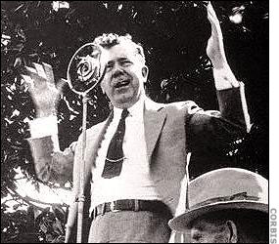

Slide 57
FDR…Continued
Labor Unions flourish - CIO, FDR supported, sit down strikes and scabs
1937 economy- caused from increased federal borrowing
Collapses again
New Deal programs were expensive and gov’t was going into another recession
National debt up
Union membership up – AFL – CIO begun
Strikes were abundant – often leads to arrests/violence and effects economy

Slide 58
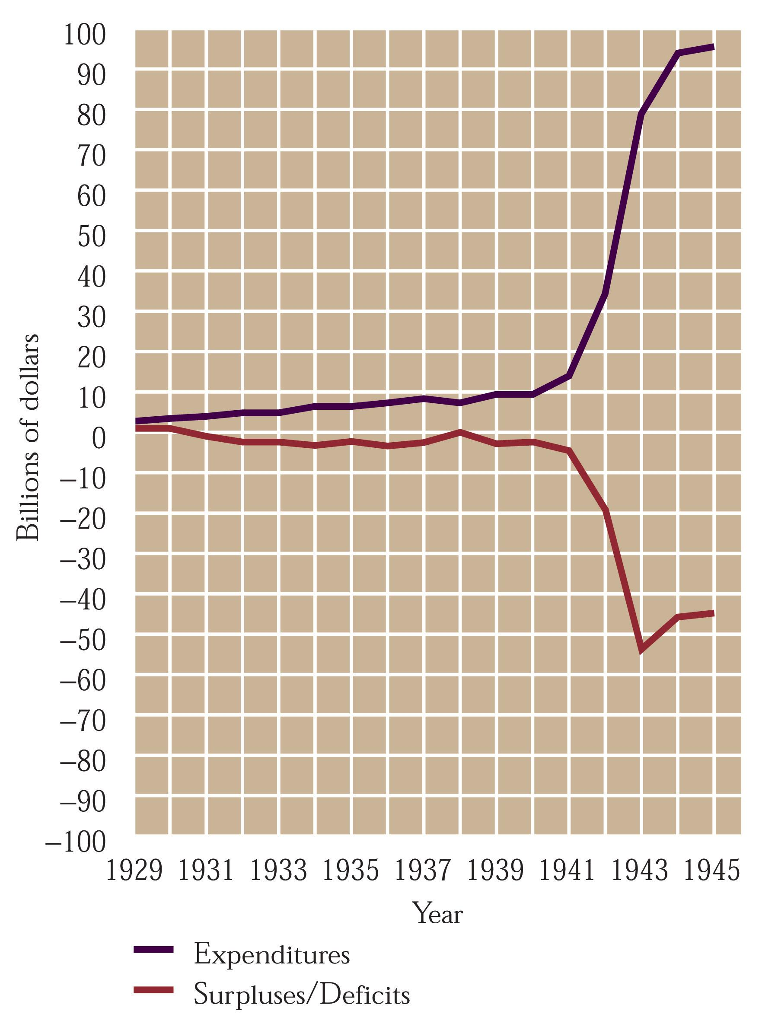

Slide 59
Culture of Depression
Escapism!
Movies : Gone With the Wind, the Wizard of Oz, Snow White
Radio: Orson Welles
American Gothic style of art

Slide 60
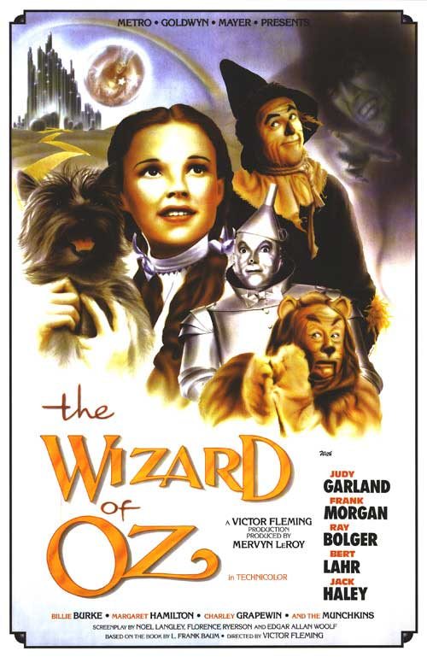

Slide 61
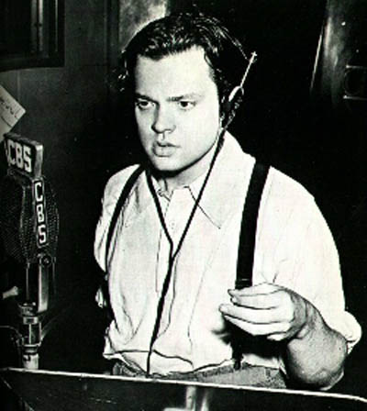

Slide 62
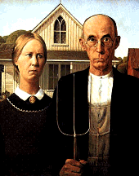
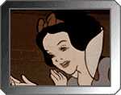
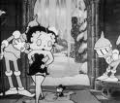

Slide 63
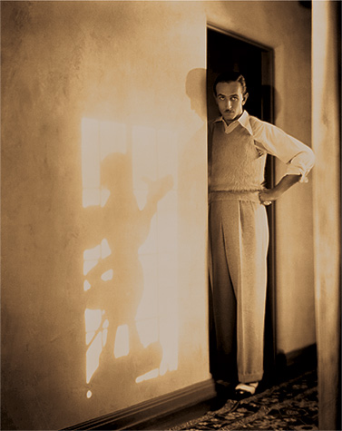

Slide 64
New Deal Successes & Lasting Effects of Depression
Buildings, bridges and parks
SEC, FDIC, Social Security, TVA still standing
*** People begin to look to the gov’t for support, and to aid needy, as well as maintain healthy economy*** - WELFARE STATE CAPITALISM
Average American regained confidence in country
Stock market takes years to recuperate
Sense of community among Americans
**Depression does not OFFICIALLY end until WWII

