Slide 1
THE 1930S
Crash, Depression and The New Deal

Slide 2
Causes of the Great Depression
Non diverse economy
Demand not keeping up with supply
Limited bank resources
OVERPRODUCTION in business and farming
Uneven distribution of wealth
European economy tied to ours – GLOBAL
Credit structure – loans, buying on credit
Loss of foreign economies and banks – loaning out for reparations from WWI/ tied into European economy
High tariffs in U.S. – foreign goods limited, creates weak structure in competition
Stock values double – people buy on margin
BUYING ON MARGIN???
9,000 Banks shut down – less money supply

Slide 3
Warning Signs and Causes
Prosperity of 1920s – US stocks top out and unemployment way down
Welfare capitalism, certain industries in trouble
Warning signs *** and Causes:
One sided wealthy – very few controlled money and industry in US
Debt/credit skyrockets
Middle/poor class buy stocks on credit (margin), which leads to ridiculous amount of interest
Farmers go broke – hard decades IN BOTH the 1920s & 1930s
Factories overproduce – not enough buyers
Rural Banks close due to no money supply
Bull Market – has to pop eventually

Slide 4
Crash Events
Oct 24, 1929 – Black Thursday – stock values begin to fall, b/c investors begin to sell stock
Oct 29, 1929 – Black Tuesday – millions of shares sold to avoid further losses – the Great Crash!
Government protections are virtually non-existent – laissez faire
Stock Market Crash – CATALYST of the Great Depression, 1929-1945

Slide 5
Effects of Crash
Factories close – no unemployment service
Part time work only if out of work
25% UNEMPLOYMENT
Federal Reserve lower loan rates – only hurts more
Small businesses close
Farming prices drop 60%!
Consumer spending non-existent
Banks shut down – call in loans, people withdraw $ from banks in fear, mattresses, banks go under
Banks Had invested deposits in stock markets
Bank Closing = NO MONEY FOR YOU
Global trading – most other industrial nations start Depression
Health, well-being, crime, morale, divorce rates, birth rate
*ALL ASPECTS OF LIFE ARE EFFECTED*

Slide 6
Republican Presidents of 1920s:
Harding: Wanted NORMAL LIFE after War/laissez faire
Coolidge: Laissez faire of business and stocks
Hoover: Minimal regulation and no real help to needy and jobless during Depression years
People will want dramatic change VERY SOON!

Slide 7
Government Response 1929-1932
Hoover says “Depression is Global, not Domestic” Said:
States and local goverment should be in charge of relief
Public Works projects, funded by banks (that are not out of business)
Raise tariffs (Promote American made) – Hawley Smoot tariff
Lower mortgage rates (Home Owners Loan Corp)
Reconstruction Finance Corps – send money to banks in danger of failing, but not enough, and not quick enough
Bonus Army fiasco – send army to break up demonstration of WWI vets who want pensions early
“pull yourself up by your boot straps” – not the government’s job to ‘cure’ poverty, homelessness and joblessness

Slide 8
Society Changes
Dust Bowl, migration to CA – “Oakies”
Lack of crop rotation PLUS drought = disaster
In retaliation of government, farmers destroy crops food supply shortage
Crime – Bonnie and Clyde – heroes
Theft, boot legging
People ride trains illegally – “Rail boys”
Families
Divorce drops
Drop out rate of school up
Crime and suicide both up
Races
Blacks fired to give jobs to whites, both in North and South

Slide 9
Life in the Depression
Little public relief, private charities only breadlines, Red Cross, riding rails for travel/boys
Individualism remains high – people blame themselves for hardships, not government
Dust Bowl – Okie culture
Hoovervilles, flags
Media – seen as means for escape, radio, movies
Novels – Grapes of Wrath, Waiting for Lefty, Tobacco Road
Women – wives and mothers try to go into job market feminism at all time low
Domestic system – clothes, food
Divorce down, births down, suicide and drinking up
No welfare, just destitution
“Mattress” mentality for savings, spending, and economy – Banks to blame

Slide 10
Hoover’s Response
Dawes Plan – private loans to Germany to repay debt
Use government spending to fight Depression, but only in conservative ways
Not too concerned with plight of average American – at least in appearance
Stay within budget – Hoover Dam, CO river
Hawley Smoot Tariff – 60% increase on tariffs recommended – disastrous, designed to help farmers
TVA vetoed by Hoover
Norris La Guardia Anti-Injection Act – outlawed anti-union contracts and forbade the federal courts to issue injunctions to restrain strikes, boycotts, and peaceful picketing
Farmer strikes, Bonus Army fiasco

Slide 11
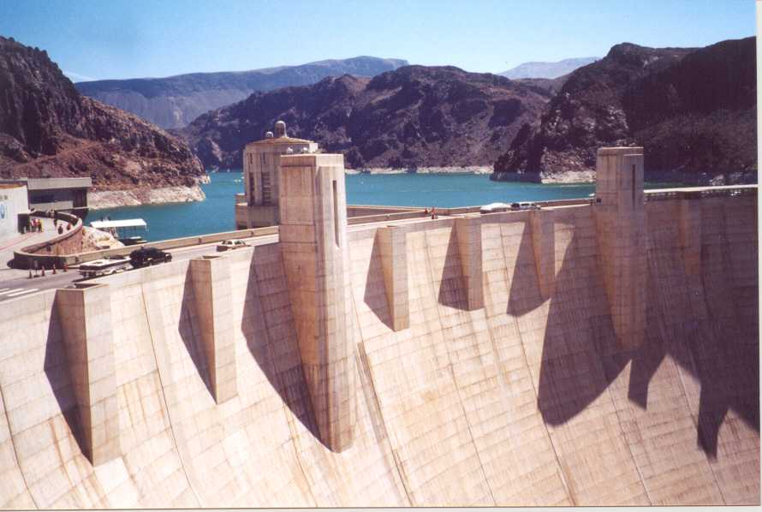

Slide 12
Election of 1932
Franklin Delano Roosevelt (New England Senator) vs. Hoover
Banking crisis helps
Hoover blamed for Depression and lack of help
“Happy Days are Here Again” – FDR had incredible optimism – never outlined a plan for getting out of Depression during campaigning, but a balanced budget…(yeah right)
Here comes deficit spending…
Blacks politically switch from Republican to Democrat party

Slide 13
Covering up the Polio

Slide 14
Franklin Delano Roosevelt
FDR – seen as ‘ordinary guy’ and optimistic
Wins in landslide – “we have nothing to fear but fear itself”
Also – wants to help people economically – sees as government’s responsibility in times of crisis
New Deal and fireside chats would he have been elected if there was a TV in every home?
Keynes economics – government spending = recovery
“New Nationalism” – government works with business to get out of financial ruin
Election of 1932 will change the way Americans see the role of government and social welfare programs
New Deal is what FDR promises to promote economy, jobs, and end homelessness – RELIEF, RECOVERY, REFORM
Eleanor is wife – promotes New Deal – takes on new role as First Lady
Will be known to fight for children, poor, African Americans, women

Slide 15
Eleanor – A New Kind of Frist Lady First To Make Speeches WITHOUT Her Husband
“A woman is like a tea bag… you never know how strong she is until you dunk her in hot water.”
“If a friend fools you once, shame on them. If they fool you twice, shame on you.”

Slide 16
New Deal – RELIEF, RECOVERY, REFORM
First One Hundred Days of presidency
Emergency Banking Act
Banks closed, and inspected by government – bank holidays to keep from further withdrawals
Result: people confidant again to store money in banks, banks can make interest and make loans
Glass Steagall Act – FDIC/ no speculation on stock market from banks
Federal Emergency Relief Administration
Public Works Administration- construction work
Civil Works Administration (CWA) – 4 million jobs created improving roads, parks, etc.
Civilian Conservation Corps (CCC) – men restore national parks, beaches, forests, etc.- FDR’s favorite and most celebrated

Slide 17
New Deal – RELIEF, RECOVERY, REFORM
National Industrial Recovery Act(NIRA)
Increases industrial prices - sets up codes of fair competition
Sets wages, hours, conditions of workers – Fair Labor Standards Act
Securities and Exchange Commission (SEC)
Regulates trade and stock
Tennessee Valley Authority (TVA)
Provide cheap electric and hydro electric to Appalachian region – in exchange of coal
Agricultural Adjustment Act (AAA)
Agricultural, raise farm prices/ paid farmers NOT to grow crops, or kill livestock

Slide 18
FDR Criticized
Some see these agencies as unconstitutional
Deficit Spending and Keynesian – even when the government doesn’t have the money to spend, they must in order to stimulate the economy
“Black Cabinet” – Eleanor and FDR promote more African Americans than any other president up to date
Court Packing! – separation of powers violated???
In response to NRA and AAA deemed unconstitutional
Eventually, FDR appointed 9 justices
American Liberty League – formed to oppose New Deal

Slide 19
Second 100 Days/2nd New Deal
1934, 1 year later- focused on ‘average’ American and welfare state
Works Progress Administration – increased projects/jobs
Farm Security Administration
National Housing Act – low cost housing – government buys faulty mortgage notes
Wagner Act passed
Legalizes unions and maintains fair practice
Child labor illegal, and minimum wage set
Social Security – gets elderly out of work force
Retirement funds at 65 years
Unemployment insurance
Physically handicapped

Slide 20
FDR & The New Deal
FDR wins second election, but New Deal sees criticism by rich, Republicans, and big business
New Deal did little for women, blacks, minorities
FDR afraid of alienating Democrat voters, did not cover domestic jobs
Some saw New Deal as form of socialism laissez faire dying and government control too strong – wealthy taxed more
Demagogues – staunch oppositionists of New Deal
Use exaggeration and fabrication of truth and fact
Huey Long – ‘Share the Wealth’ – very socialist with ideas, and assassinated
Father Coughlin – Old Age pension for everyone

Slide 21
FDR & The New Deal
Roosevelt recession – 1937 – solution – to spend more on public relief
Unemployment still at 15%
By 1938 – new Deal had ended – not out of Depression yet, and class divisions still high
Criticism: reckless spending, attacks on free enterprise, no relief to retirees

Slide 22
Culture of Depression
Escapism!
Movies : Gone With the Wind, the Wizard of Oz, Snow White
Radio: Orson Welles
American Gothic style of art

Slide 23
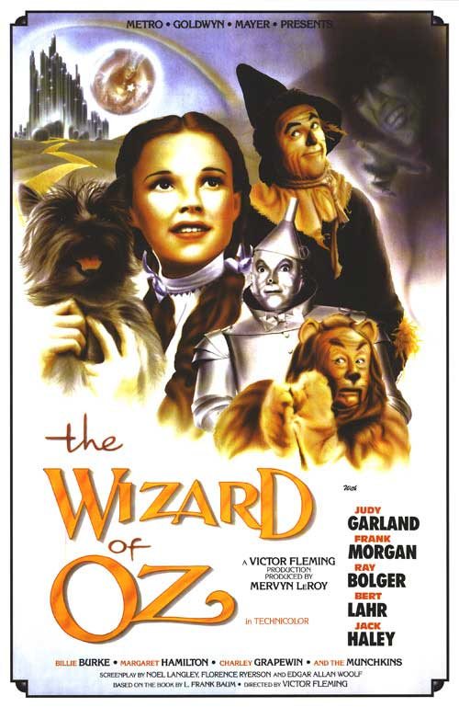

Slide 24
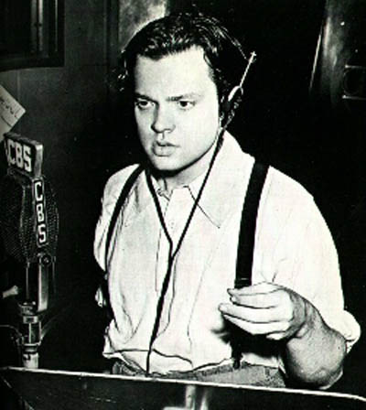

Slide 26
New Deal Successes & Lasting Effects
Reformed capitalism
Modern liberalism was born out of progressivism
Actually enhanced private enterprise by increasing positive regulation
Conservative voices were silenced but not wiped out completely, regarding “Gilded age” policies of doing business
Did not completely alter class divisions
Buildings, bridges and parks
SEC, FDIC, Social Security, TVA still standing
*** People begin to look to the government for support, and to aid needy, as well as maintain healthy economy*** - WELFARE STATE CAPITALISM
Average American regained confidence in country
Sense of community among Americans
**Depression does not OFFICIALLY end until WWII**

